Slide 1
Improving Customer Experience and Outcomes
Joanne McGowan
VP Customer Experience and Strategy Execution

Slide 2
Agenda
Context
CoreSource Philosophy and Goals
Customer Needs Defined
A Member/Consumer Perspective
Solutions
Members Tools

Slide 3
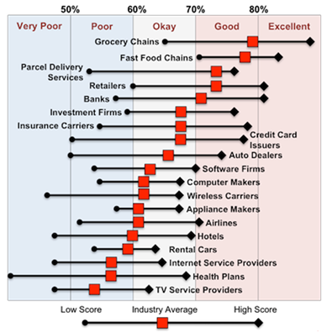
Trust and Reputation of the Industry is Poor
Health Plans rank low in Experience rating relative to most other industries.
2014 Temkin Experience Ratings, Range of Scores by Industry

Slide 4
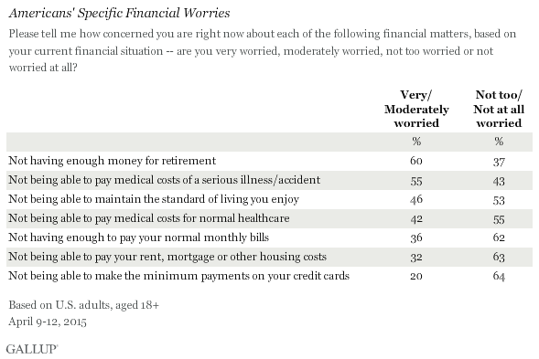
Consumers Are Worried About Healthcare Costs

Slide 5
Employers Want Solutions that Drive Improved Performance
Strategic advisor
Consults on forward looking employee and benefit strategy
Proactive benefit partner
Helps us manage our costs with the right recommendations & programs that match our business and employees
Hierarchy of employer needs
Core health benefit provider
Solid performance on the basics—network strength, customer service, claims processing, competitive cost

Slide 6
Ease for Employers, Thought Leadership on Cost Savings & Employee Customer Service Drive Partner Decisions
Claimed vs Correlated Importance
62%
Required
Crucial
Required
Crucial
Effective customer service for employees and employers is very top-of-mind while also driving purchasing in the category
60%
Promptly handles claims
Effective customer service for employees
Responsive to us
Helps us manage healthcare costs
Answers questions correctly on first time
58%
Accurate claims processing on first time
56%
Cares about employees & treats them well
Regulation/reporting compliance
Helps us address healthcare needs affordably
54%
Manages eligibility without errors
Understands self-funded needs
Claimed Importance - % Very Important
Online portal easy for us
Seamless with our operations
52%
Good network access
Customized to fit our needs
Makes administering plan easy
Provides objective advice
Key crucial and motivating benefits relating to thought leadership on cost savings for the employer
50%
Understandable enrollment materials
Delivers healthcare cost savings for profitability
Mitigates financial risks
48%
Real-time utilization data
Makes me feel like a priority
Helps keep us current on trends
Understands needs of employees
Employee brand confidence
46%
Flexible reporting
Gives insight on utilization
Seamless with other vendors
Makes management less stressful
Ability to choose PBM
Continuity in contacts
44%
Flexible enrollment
Online resource for employees
42%
Saves us costs via employee health
Helps employees be healthy
Trusted by my broker
40%
Consolidated billing
38%
Uninspiring
Wellness program
Motivating
36%
Correlation to Future Purchase Intent (Q36)

Slide 7
Brokers are a valued resource that have a large impact on employer decisions, essential in the employer experience and overall ecosystem
Employer Insight: “I don’t have the time or expertise to understand all our options and make sure we are getting the best value, or doing what’s best. I trust our broker to advise us and do what is right for us. They are unbiased and know the market well. “
Evidence:
Majority of employers use a broker
HR leaders described brokers in very positive, emotional language
Brokers are an extension of the HR team-offloads work and analyses
Employers described valued roles for the broker throughout the experience
Broker trust is an essential purchase decision factor
Implications:
Brokers need to be able to represent provider/TPA’s value, plans, and member experience well
Broker tools and reporting that enable their success; comparison tools, trend reports, etc.
The employer experience includes the broker, need to set our relationship to reflect this

Slide 8
Employer’s Words
“Broker does the leg work in the evaluation process”
“We pay them (our broker) to get us the best cost and inform us about what is going on.”
“Our broker does a really good job. We want an unbiased opinion. I want someone that is in the industry and not self serving. I love ours—very good. Having that access is great, I don’t have time to be the health and wellness guru. I am good at doing my homework and reading the recommendation but can’t do all the raw search work.”
“Broker’s value is that he is able to be an advisor to us, he is connected to different carriers, he advises us on a number of different roles and services.”

Slide 9
CoreSource Direction and Perspective
Customer Centricity is a deep understanding of your customers and what need they really want solved.
Customer Experience is what happens & how your customer feels as they realize they have a need, learn about options, evaluate, make a decision, start using your service and evolve to new needs.
Advocacy is both a product and a customer experience philosophy that drives better engagement leading to better outcomes.

Slide 10
Understanding Our Customers & Their Needs
Our Employers
Our Members
We need a competitive benefit plan to attract and retain great employees that we and our employees can afford. We want our employees to use and value our benefits.
We have to know and solve the members’ needs well to solve the employers’ needs
I want to make sure we make the right decisions about our health plan and how we use it to protect our family’s finances and health. I want to understand and feel confident about using my benefits.

Slide 11
Translating to Actions
Our Employers
Our Members
First Area of Focus:
Reporting & Data Analytics that are simple and insightful
Recommendations with appropriate programs and products to drive engagement & reduced cost
Thought leader on member needs
Which means:
Lead with what is important to the member—drive engagement
Proactive and personalized—predictive analytics to meet the member where they are
Easy to use member tools—portal, mobile

Slide 12
Delivering Better Outcomes
Our Employers
Our Members
Essential Outcomes:
Improved medical cost trend
Strong benefit program utilization
Simpler administration
Confidence
Essential Outcomes:
Smart, informed and confident healthcare consumers
Higher engagement for all programs
Reduced member stress

Slide 13
Knowing, guiding, and advocating for the consumer ladder up to increased consumer confidence
Know
Guide
ME
Advocate
Distill it down to what I need to know, but give me all the information, so that I am more confident in myself as an insurance customer.
Guide me to the right course of action – I am ultimately the decision maker, but I want your support in helping me figure things out, ultimately building my confidence in our relationship.
Advocate for me, and in doing so, build my confidence and trust in you.

Slide 14
A cloud of questions… with no easy way to answer them
What is a
deductible again?
What if I pay all this money and never get sick?
What if someone in my family needs to go to the hospital?
What will my routine doctor visits cost?
How much will my prescriptions cost?
How do I plan for the unexpected?
What is co-insurance?

Slide 15
Risky or uncertain financial decisions cause dread in the hearts of consumers…
“The biggest dreadful decision I make is where to direct my money each month. I generally try to stick to a plan, but finances are sometimes not the most fun thing to deal with.”
Rachel W. | 30-39 | Young Single Insured through Employer | Healthy
“Our health insurance open enrollment a few weeks ago was one that I didn’t really enjoy. My employer was getting rid of our old health plan due to cost and introducing a new high deductible one as well as an HMO but that would cost more than our old plan did. It took my wife and I quite a while to run the numbers and decide what was best for our family in the long run.”
Sean B. | 30-39 | New Family
Insured through Employer | Chronic
“I dread making decisions related to shopping for auto and home insurance, credit cards, financial decisions, etc. These decisions cause me dread because I don't enjoy shopping for these products and I often feel overwhelmed.”
Melissa S. | 21-29 | Young Single
Insured through Employer | At Risk
“I struggle to make decisions about finances because I want to do things that I might not be able to afford. Then there are other decisions I know I have made that cause me stress, but I always decide to do what I think is best for my family and me.”
Robin B. | 40-49 | Mature Family
Insured through Employer | At Risk

Slide 16
Healthcare costs = an equation that never quite adds up
Consumers can generally predict the cost of consumer goods and services they purchase…from milk to gasoline to laptop computers…they have the ability to judge whether something is too cheap, too expensive, just right
In the world of healthcare, consumers can’t understand:
Why healthcare services cost what they cost, and why those costs can be variable
How the provider and insurer interact to decide who pays what, and how much
This is why they feel positive about clearly-stated, routine costs (you always pay $40 to see an in-network specialist) and at a loss when it comes to variable or unpredictable costs (the MRI they didn’t expect to need, the extra co-pay they pay when another doctor visits their hospital room)
The former fuels loyalty and positive regard
The latter fuels distrust and worry

Slide 17
Bring On The Forms and Red Tape
Consumer Wants | Consumer Gets
Quick, easy, straightforward paperwork | Multiple, repetitive, sometimes confusing, forms to fill out
Understandable policy description w/o insurance-ese | Pages of explanation, bewildering description, “foreign” language
Guidance, when needed, throughout the process | To navigate alone unless assistance is provided by company’s HR
Communication expressing appreciation from insurer | Inundated with insurance information, not necessarily appreciation
An invitation to connect with an insurer who cares | The feeling there’s no use to reach out; no help is to be had
Stress-relief | STRESS

Slide 18
CoreSource Connect 2.0
Guiding Member Choices & Advocating To Optimize Benefit Utilization
Today
Future
Lead with members’ need to limit financial risk and surprises
Proactive via predictive analytics
Assemble best in class tools and products and bundle with Connect-- Healthcare Bluebook, Teladoc, etc.
Personalized outreach—”Scott here is a list of great Imaging Centers for your MRI”
Intercept inbound calls with CRM notations
Data mining for the top cost drivers for each client (e.g.-gaps in care, ER use) and consultative approach about all the levers to address
Data analytics aid effectiveness and deliver strong employer ROI
Integrated
24/7 coverage for all benefits questions
Includes all of the client’s benefit services and products
True advocacy is driven by member request but low frequency
Limited ability to navigate members

Slide 19
CoreSource YourCare 2.0
Knowing How to Impact Member Health
Today
Future
Tough to reach members—telephonic intensive
Engagement is too low
Generally only focus on the highest risk members – 10% to 15%
Employer ROI is clear but needs to be improved
Current YourCare results:
6% lower costs
12% Lower Hospital Admissions
14% Lower ER Visits
14% Higher Rx Fill
Lead with member’s need to limit financial risk
Correct member contact information and preferences via new ID card registration
Broader focus across the group population—50% to 75% of the total population
Personalized communication; omni-channel
Data analytics power consumer identification & effective program elements
Test communication channels and messages to identify optimal approach
High touch guidance for members advocates
Integrated approach

Slide 20
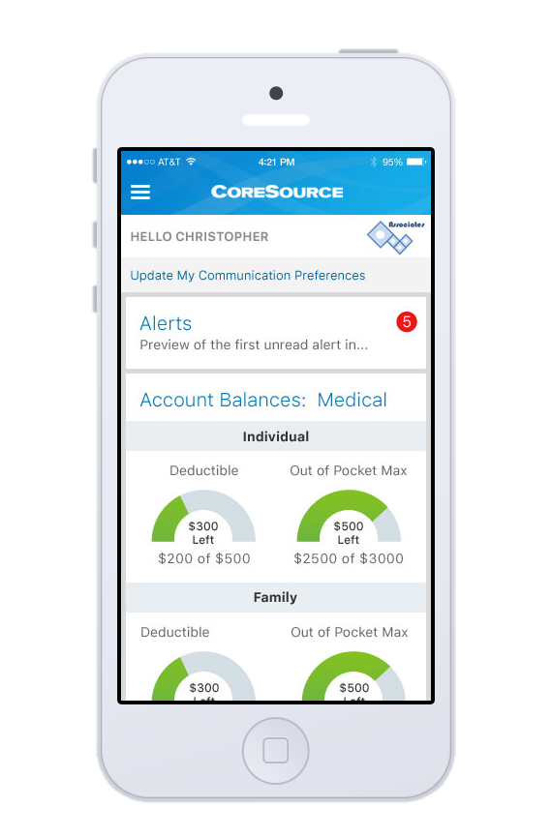
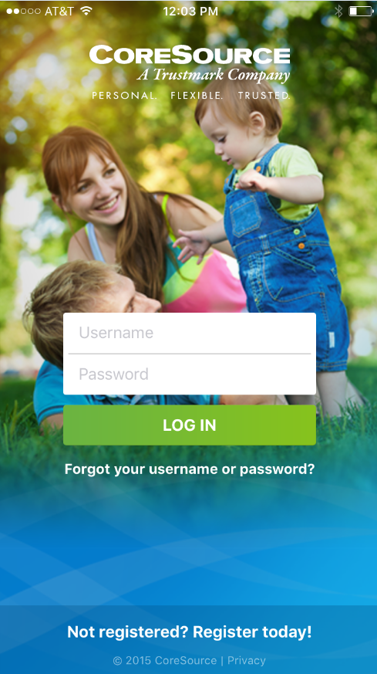

Slide 21
Good Early Results!
Download Activity
 | 6/6/16 | 6/13/16
Apple | 452 | 550
Android | 217 | 264

Slide 22
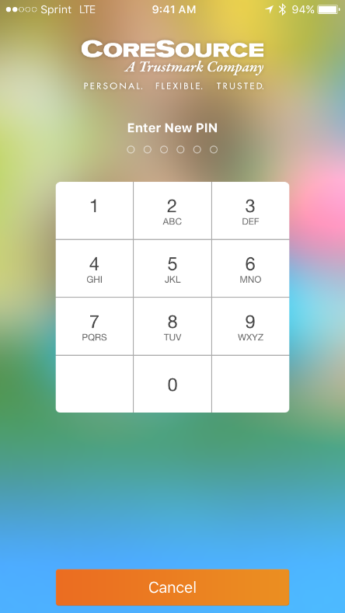
Simple, Secure Features
PIN & Thumb Print Security
Login and create a PIN
Going forward, members can use the PIN to log in; not the username/password
Access claims, ID card and documents offline
Notes:
When you sign in and get note about entering PIN make sure mention that this also works with the thumb print.

Slide 23
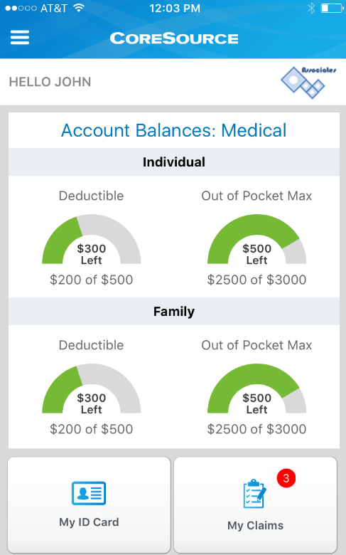
Easy Access to Essential Information
Clean Dashboard
Upon logging in, the user has access to a dashboard related to their coverage, claims and links.
FUN FACT – the deductible and out-of-pocket information will swipe if more than two configurations are available for the member.

Slide 24
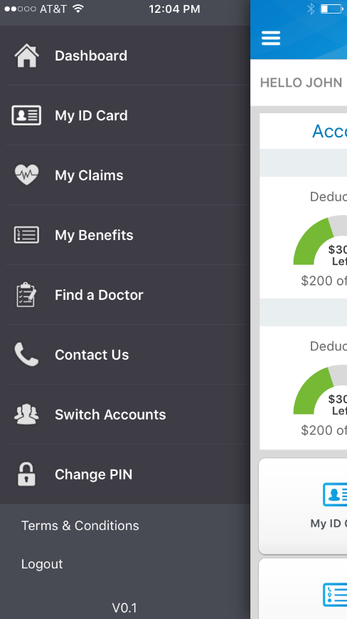
Easy Access to Essential Information
Navigation Menu
From anywhere in myCoreSource Mobile, the “Hamburger Menu” will pop out a navigation menu for all areas of the app – quickly and easily get from one place to the next without going back to the dashboard

Slide 25
Easy Access to Essential Information
Additional Features
Scrolling down the dashboard, the user will have access to links that have been configured in the Client Database – specific to THEIR eligibility (just like ICE Portal)
A “News” section exists to post quick messages to members
Contact CoreSource provides a quick button to dial CoreSource AND will route the member to the Customer Service number specific to the client they belong to.
Notes:
Reinforce the fact that this is done through a mobile build in the client database. All builders have been trained and are currently doing this. If not done, the member could still sign in, they would still see the claim link if there are paid claims, but no other links.

Slide 26
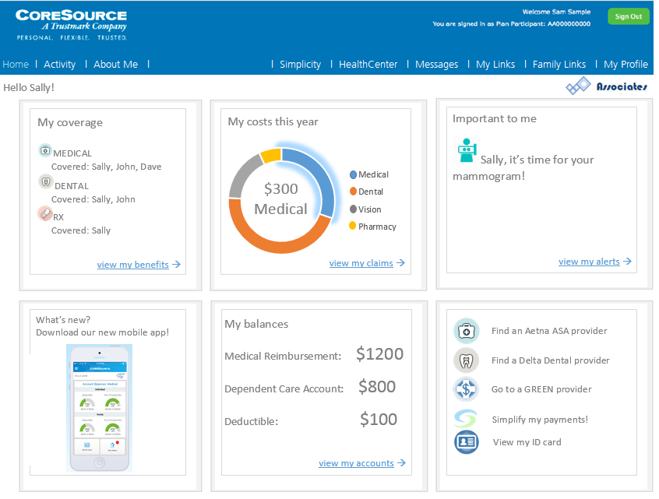
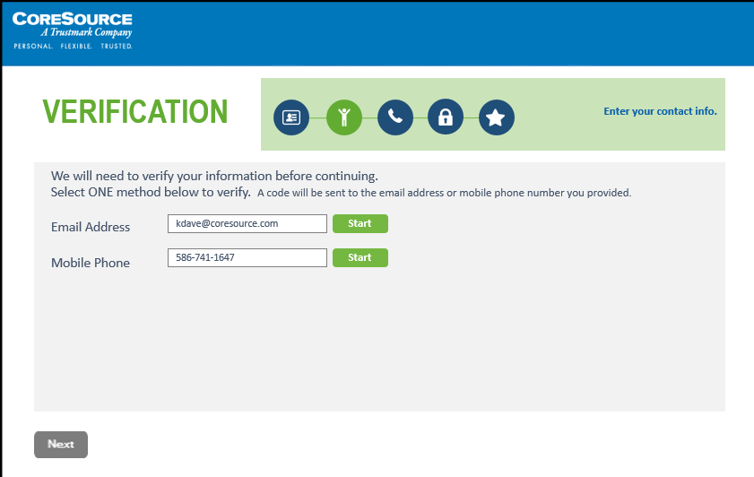
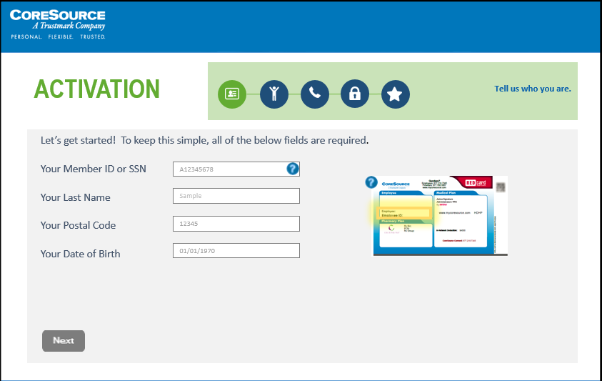
Portal Update
New registration!
We are revamping our registration process to make it quicker & easier than ever to gain access,
while still keeping it secure!
Members can let us know how they want to receive communication.
We are verifying contact information to ensure we capture valid data to enhance the member experience.
New home page!
We are giving our home page a face-lift!
Members will have dashboard access to the data that truly is important to them.
Graphs give a quick overview of a member’s current year totals.
Message alerts keep members engaged and informed on what is specific to them to help manage their healthcare dollars.

Slide 27
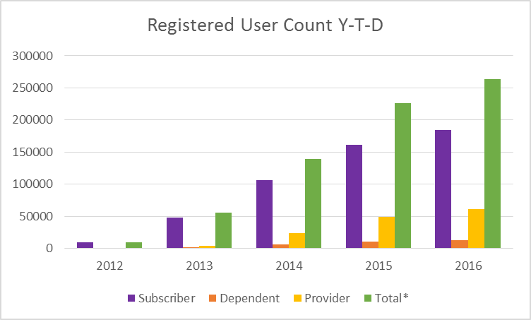
Portal Usage Continues to Grow!
Registered user count is the number of principals that have active ICE principal accounts.

